Slide 1
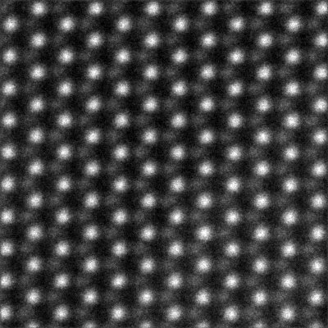
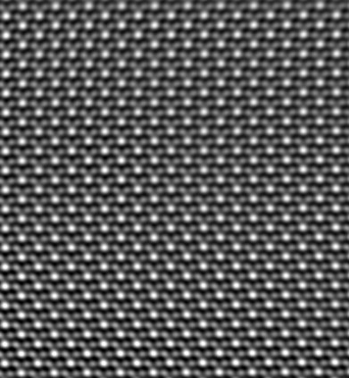
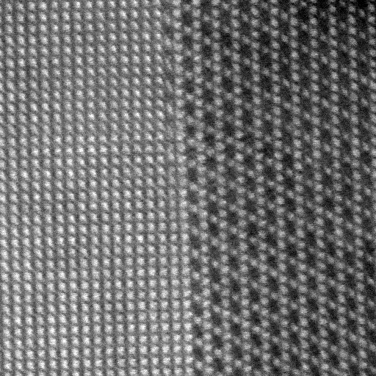
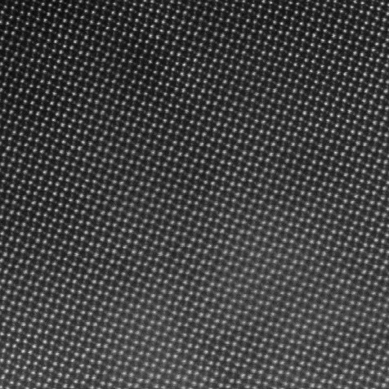
MoS₂ (Nion, 60 kV)
AML, TCD
Hexagonal WO₃ (uncorrected TITAN, 300 kV)
AML, TCD
1H-WS₂ (JEOL ARM, 80 kV)
URC, KU
SnSe₂ flakes (TITAN, 300 kV
(AFMM, IISc)
Scanning Transmission Electron Microscopy
Interface in WO₃ (TITAN, 300 kV)
AFMM, IISc
BaMnO₃ nanorods (Nion, 200 kV)
AML, TCD

Slide 2
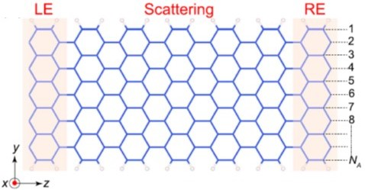
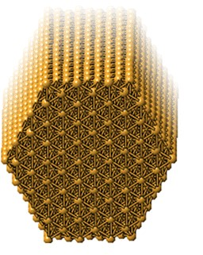
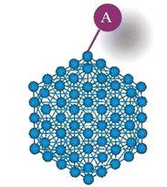
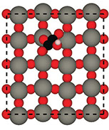
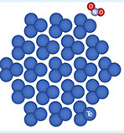
Transport in Nanoribbons
Structure of
Au nanowire
Atomic-scale Modelling: DFT simulations
Gas-sensing
with Au nanowire
Adsorption on
Te wire
Growth of oxides

